Slide 1


RedStyle fashion shop

Slide 2
Mentor and team member name
Mentor
Quach Luyl Da
Member
Vo Duy Thanh(Leader) CE160641
Tran Quoc Bao CE160365
Nguyen Nhat Chuong CE150187
Doan Minh Hieu CE160738
Dinh Hoang Liem CE160217

Slide 3
Table of content
Introduction
Use Case
Database
Function

Slide 4
Introduction

Slide 5
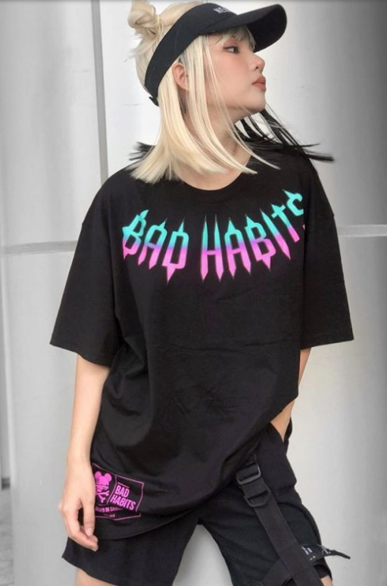
Welcome to RedSlyte
We are Group 3

Slide 6
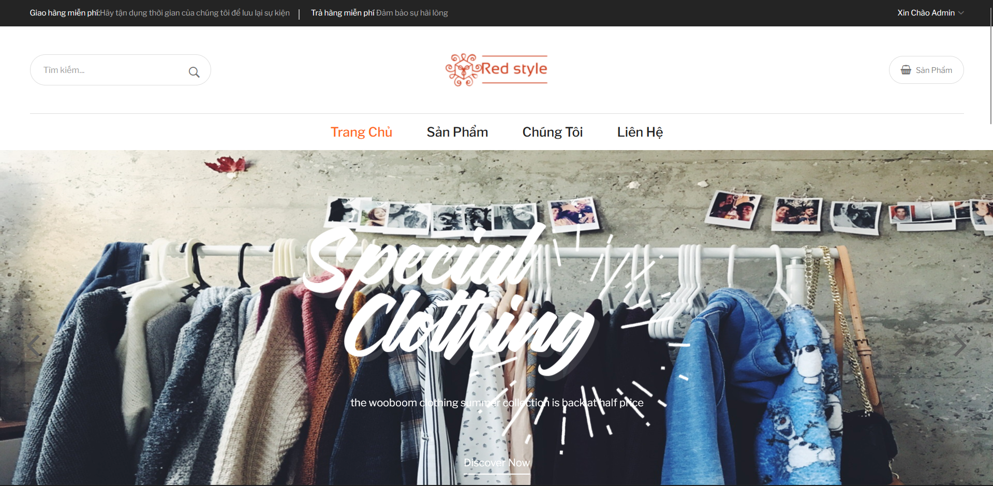
The interface of Shop RedSlyte

Slide 7
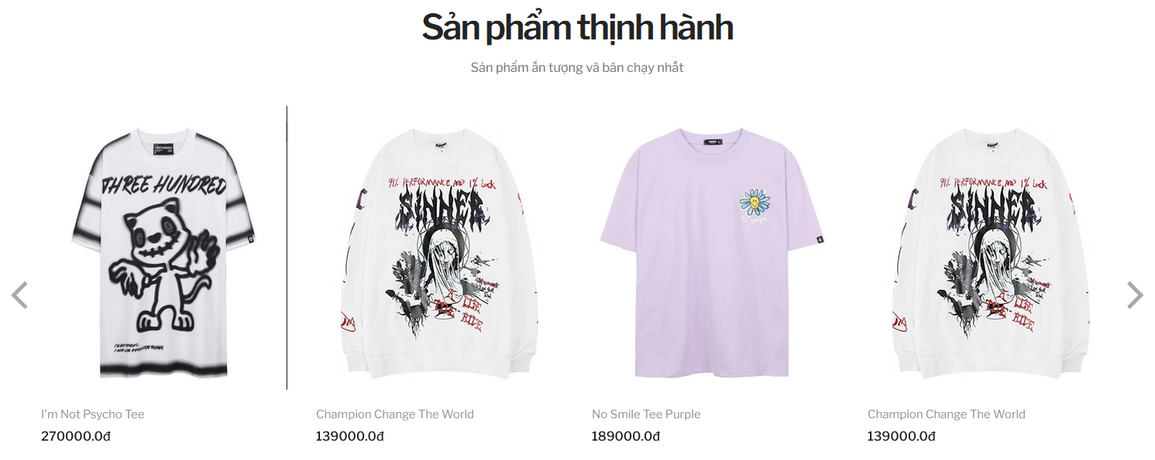
Popular products

Slide 8
II. Use Case

Slide 9
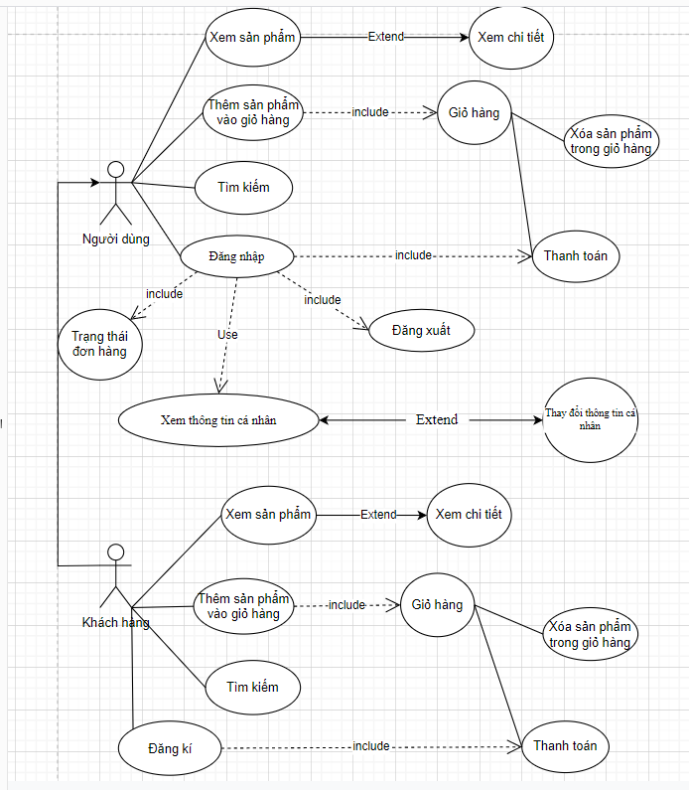
II. Use Case

Slide 10
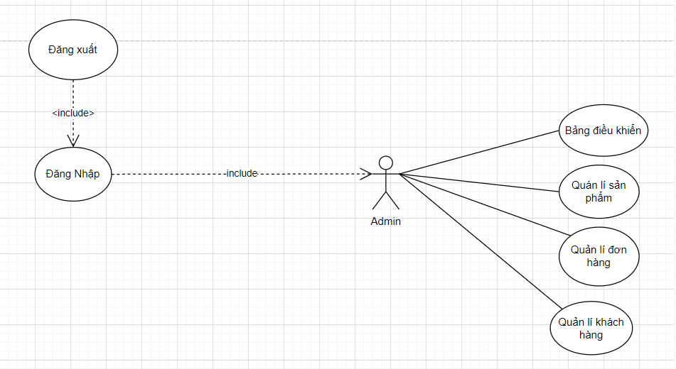
II. Use Case

Slide 11
III. Database

Slide 12
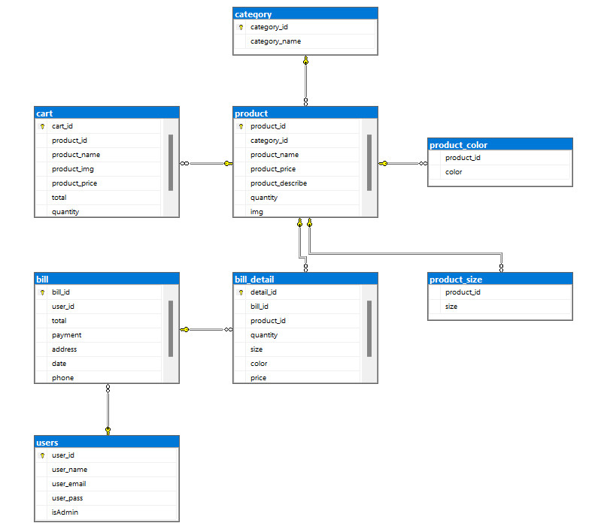
III. Database

Slide 13
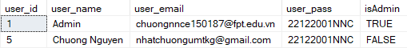
III. Database

Slide 14
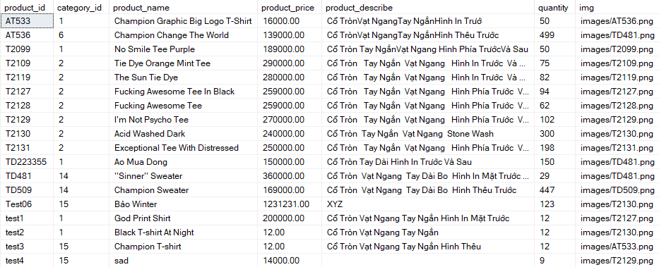
III. Database

Slide 15
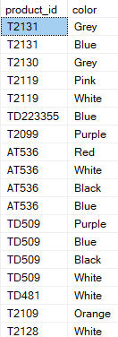
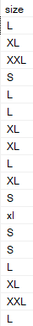
III. Database

Slide 16
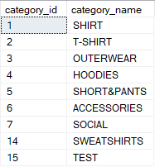
III. Database

Slide 17
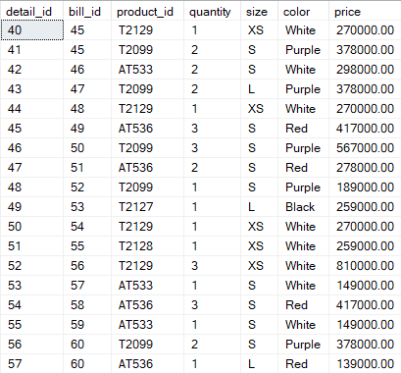
III. Database

Slide 18
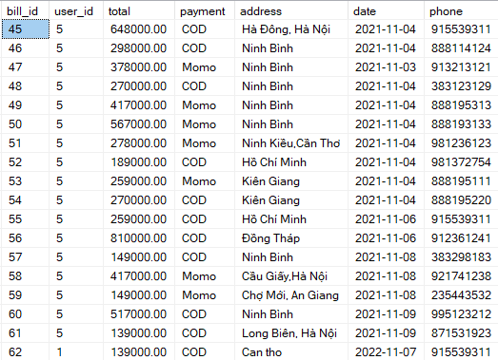
III. Database

Slide 19
IV. Function

Slide 20
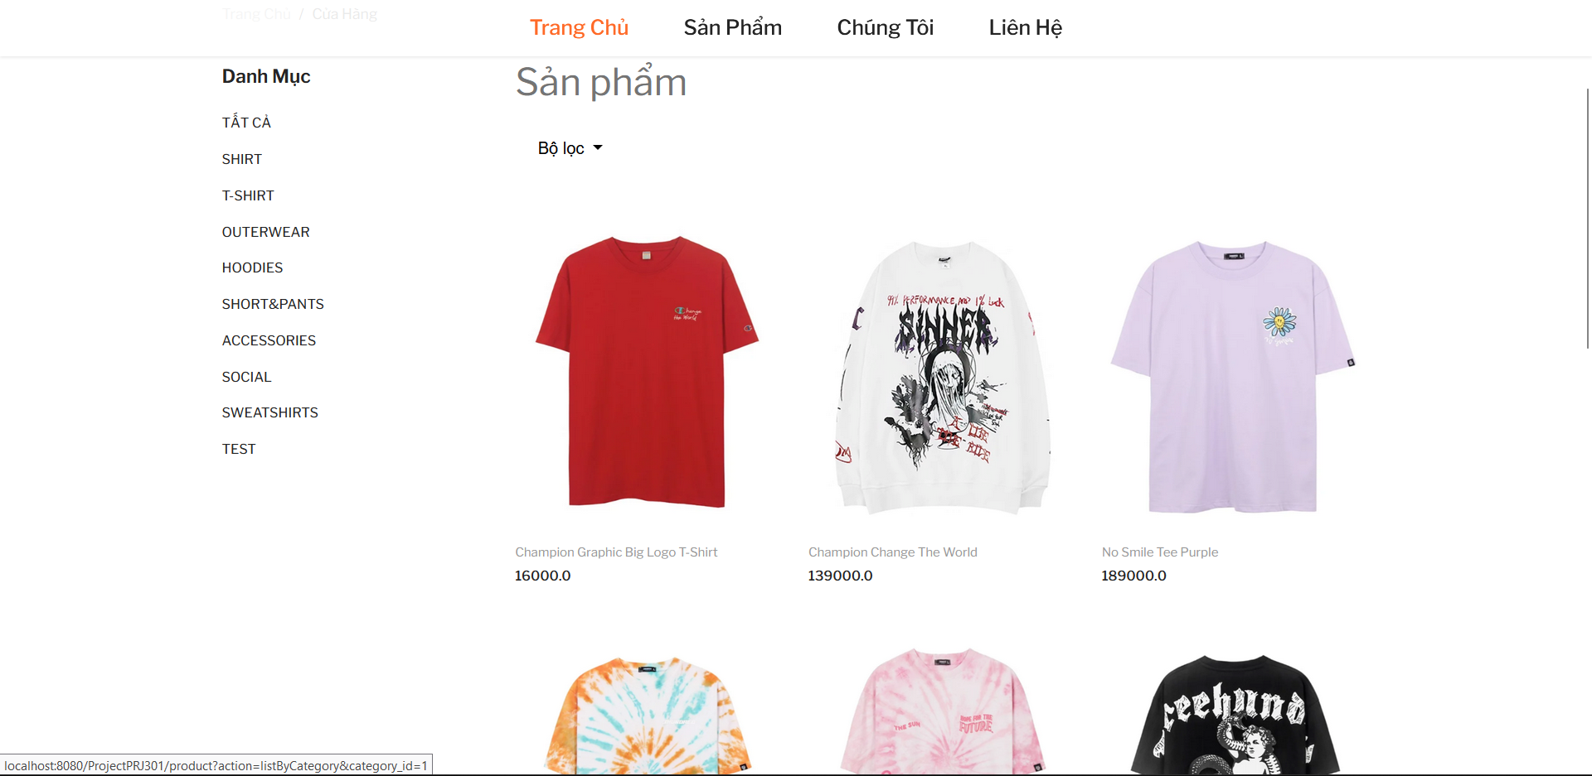
IV. Function
User
1.1 Checking goods
Cart

Slide 21
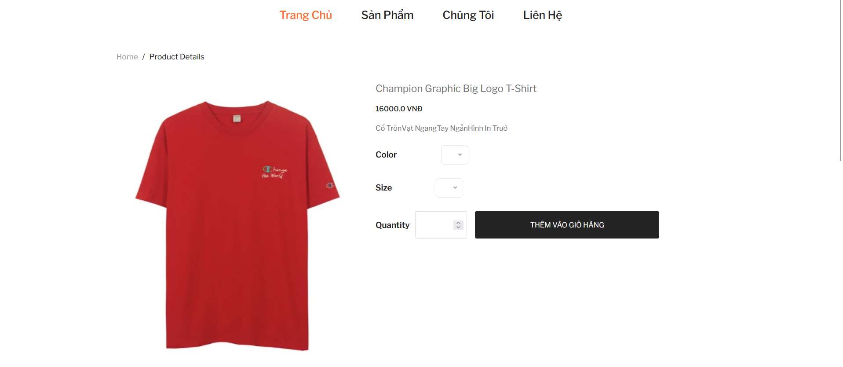
IV. Function
1.2 Place an order (add products to cart)

Slide 22
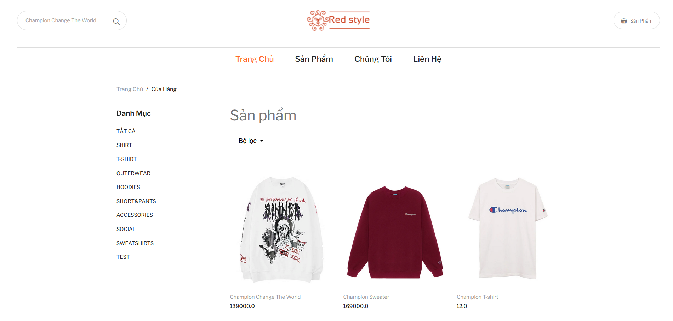
IV. Function
1.3 Search product

Slide 23
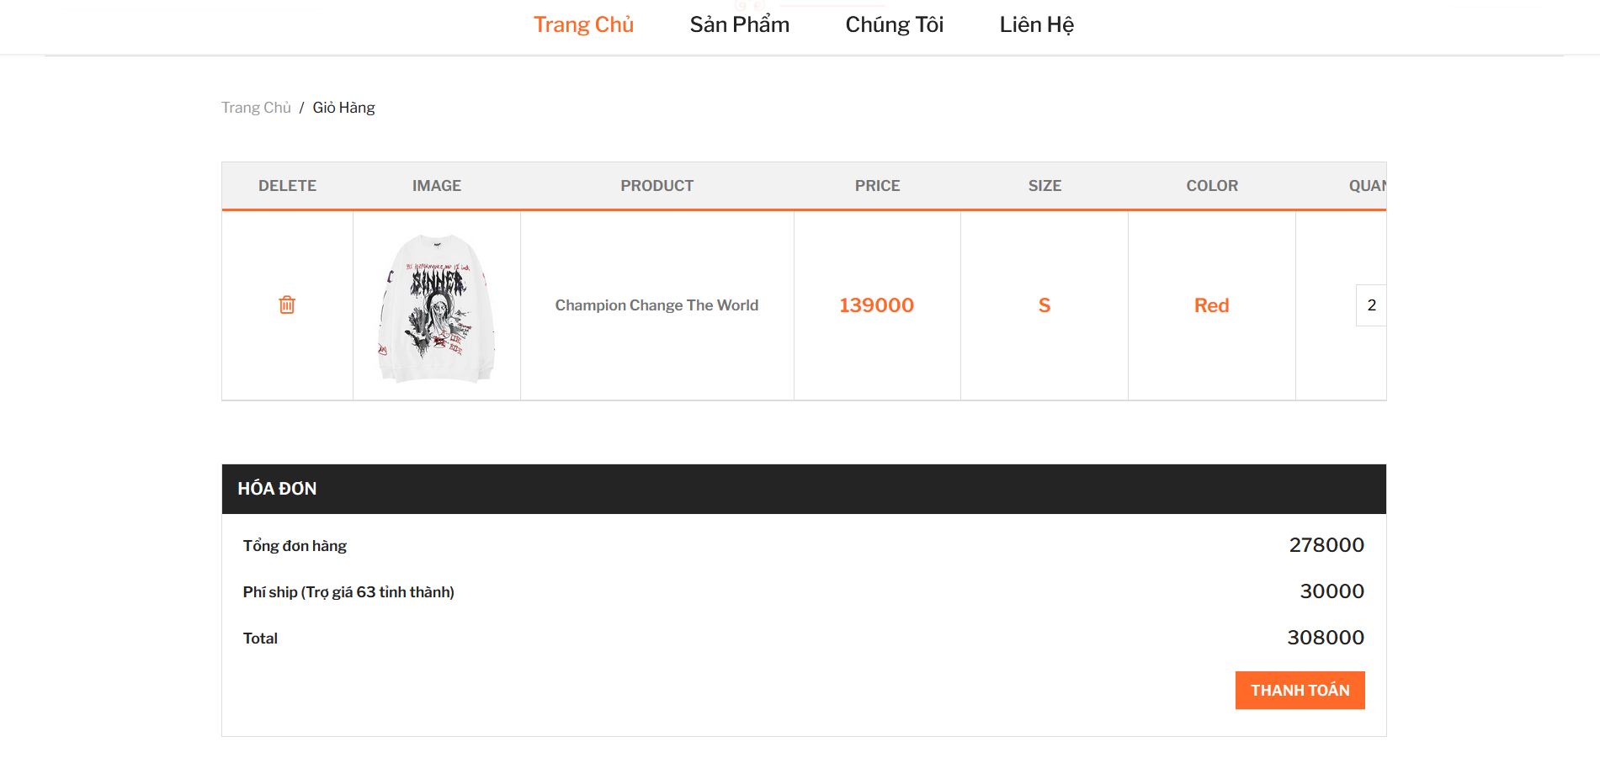
IV. Function
1.4 Cart

Slide 24
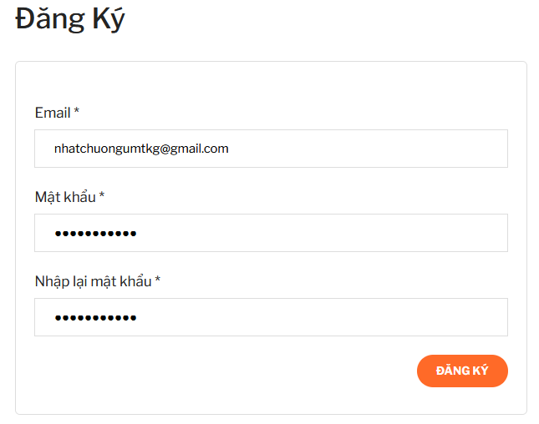
IV. Function
1.5. Register

Slide 25
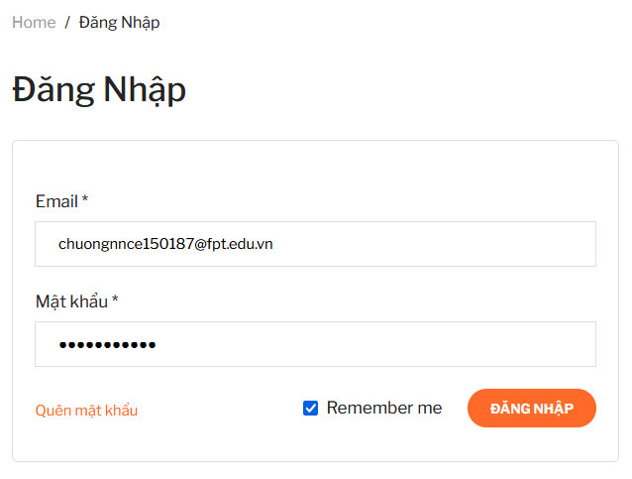
IV. Function
1.6 Login

Slide 26
IV. Function
2. Checking goods

Slide 27
IV. Function
2.1 Search product

Slide 28
IV. Function
2.2 Place an order (add product to cart)

Slide 29
IV. Function
2.3 Cart

Slide 30
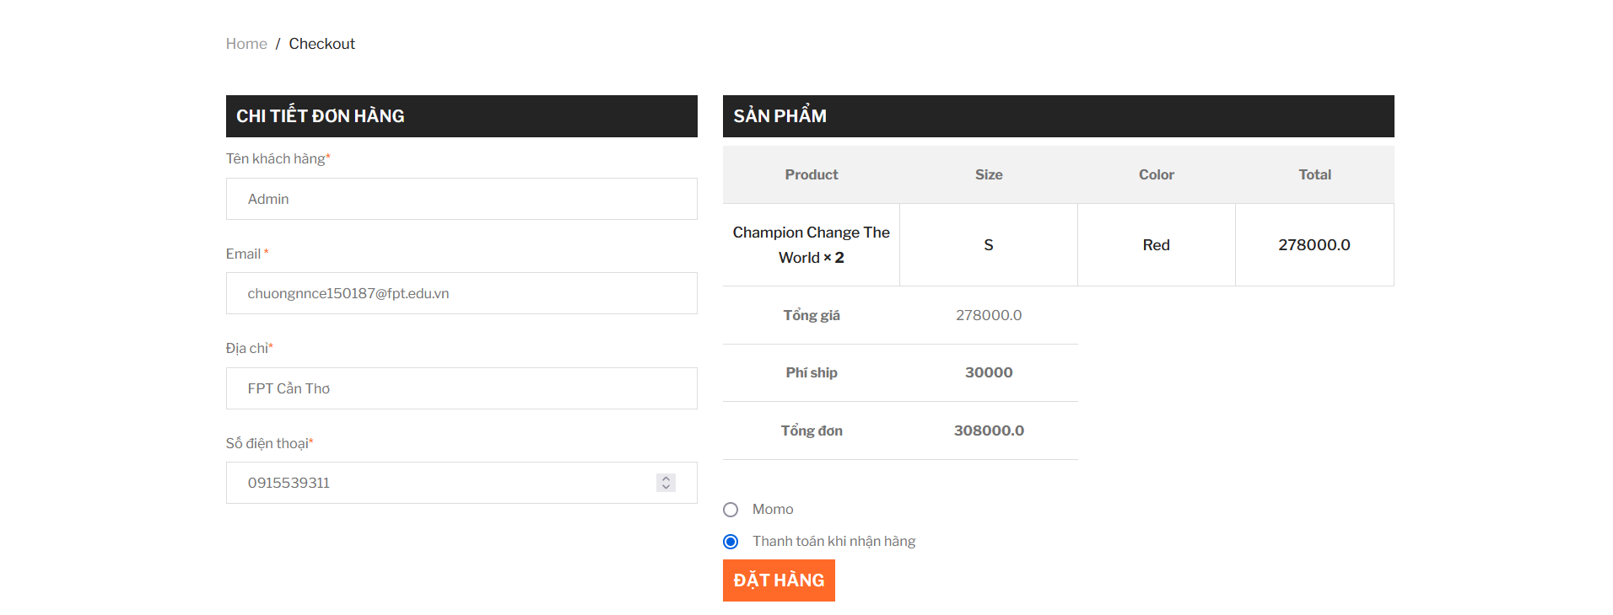
IV. Function
2.4 Payments

Slide 31
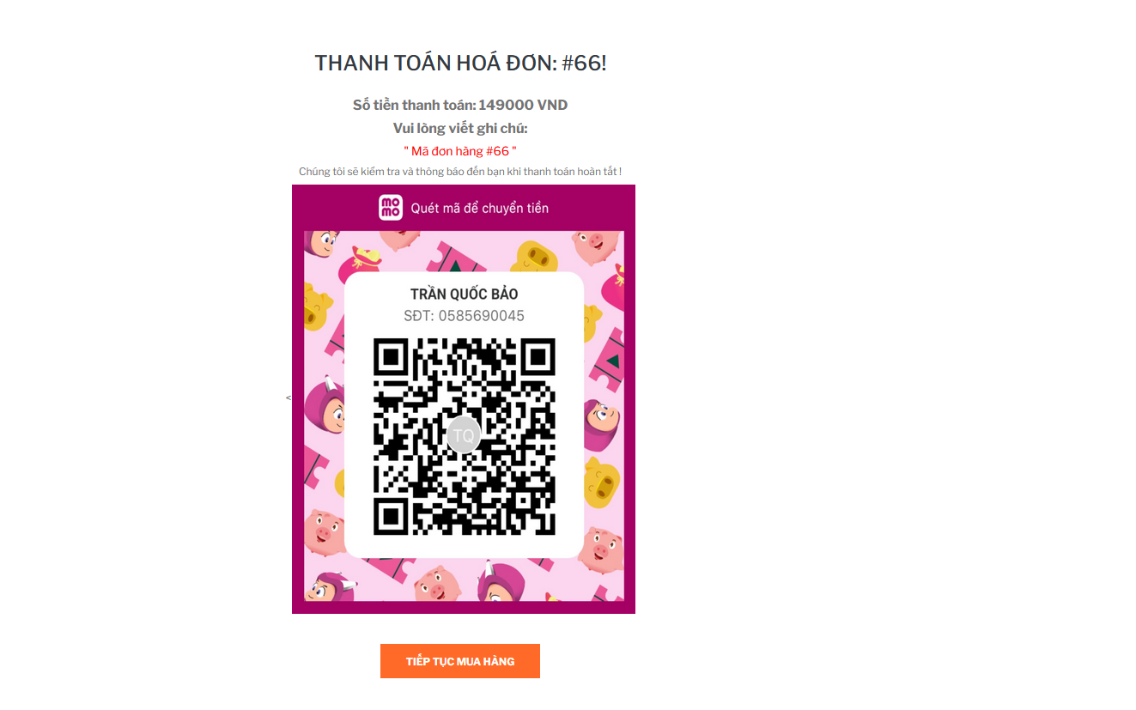
IV. Function
2.5 Payments

Slide 32
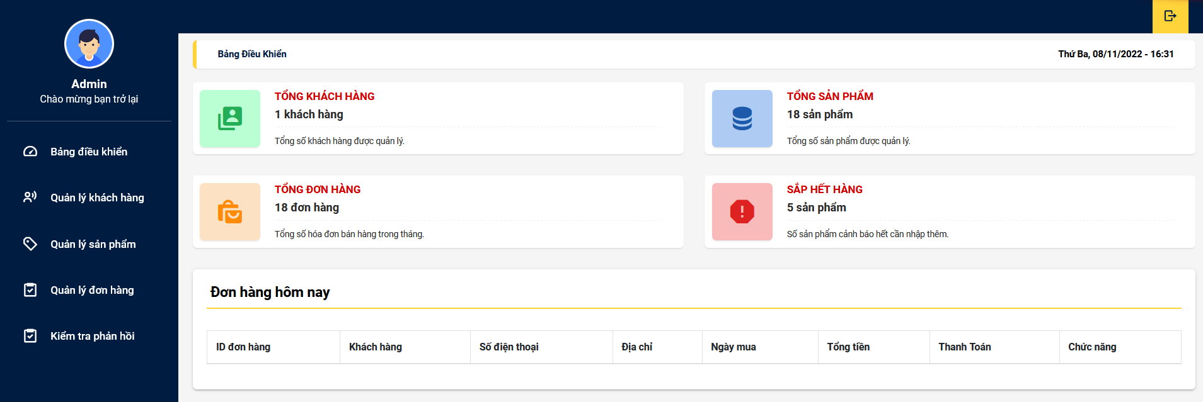
IV. Function
3. Admin
3.1 Dashboard

Slide 33
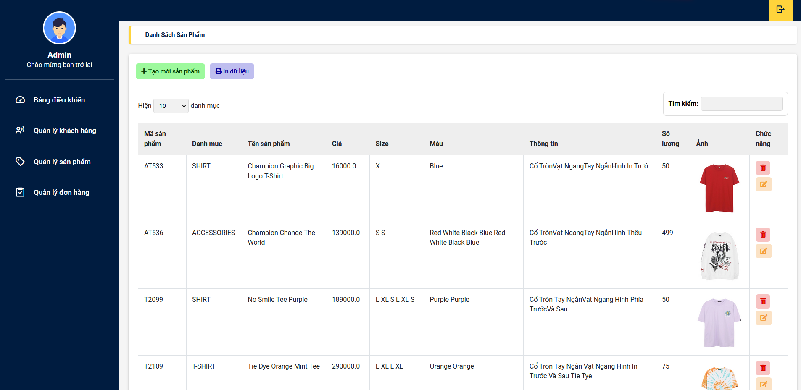
IV. Function
3.2 Product Management

Slide 34
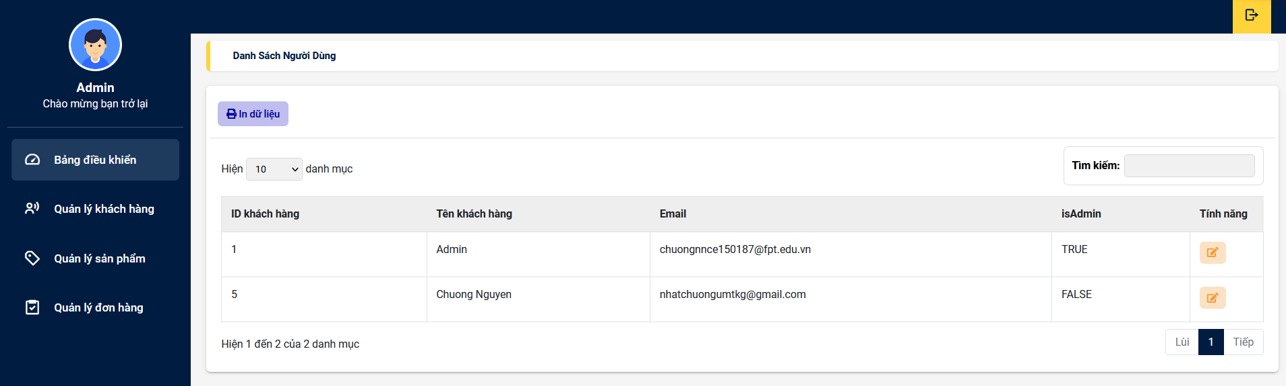
IV. Function
3.3. Customer management

Slide 35
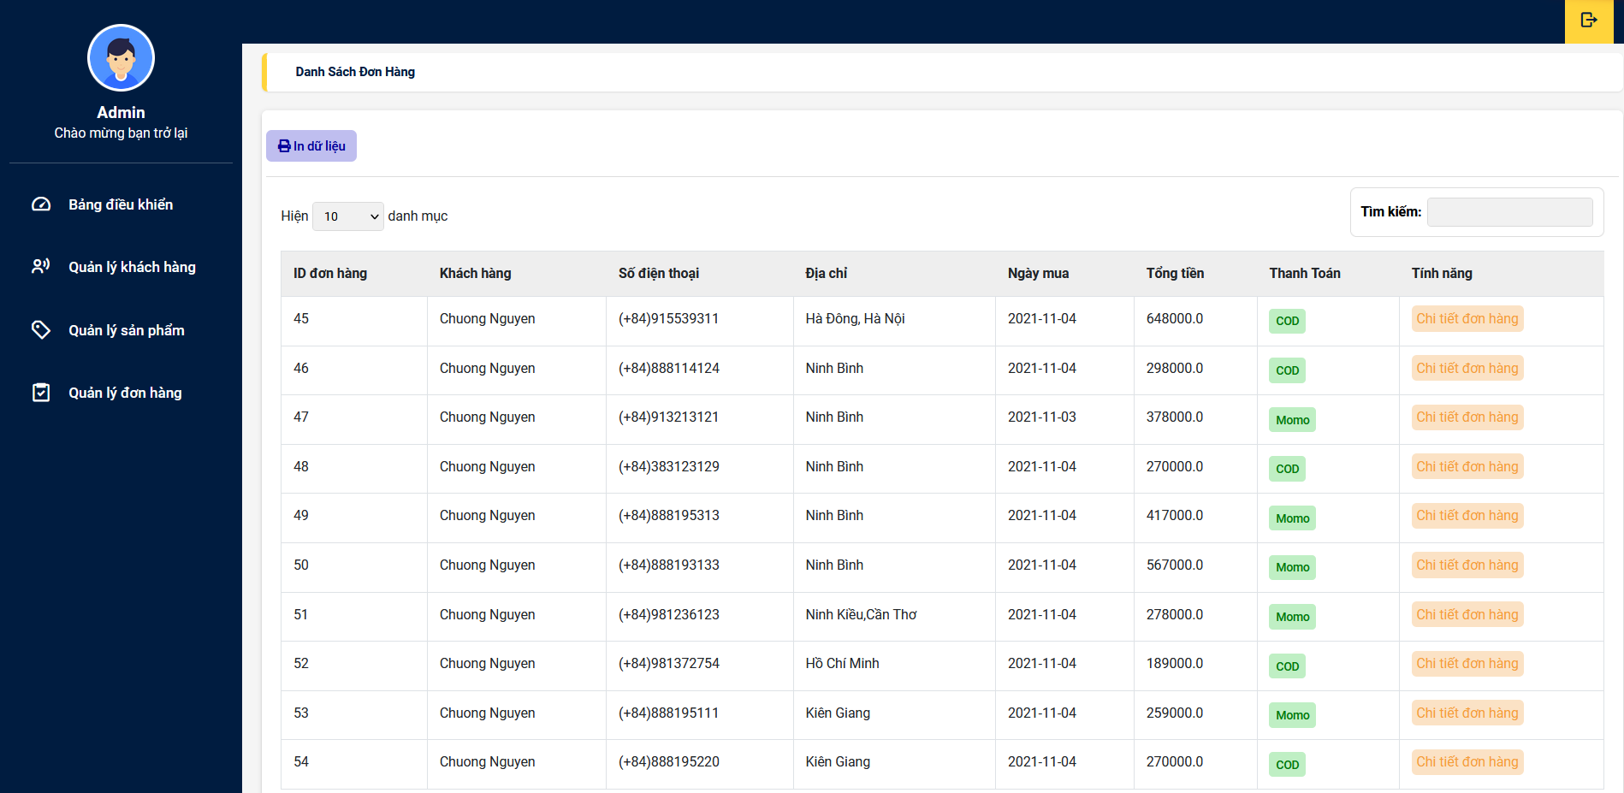
IV. Function
3.4 Order Management

Slide 36
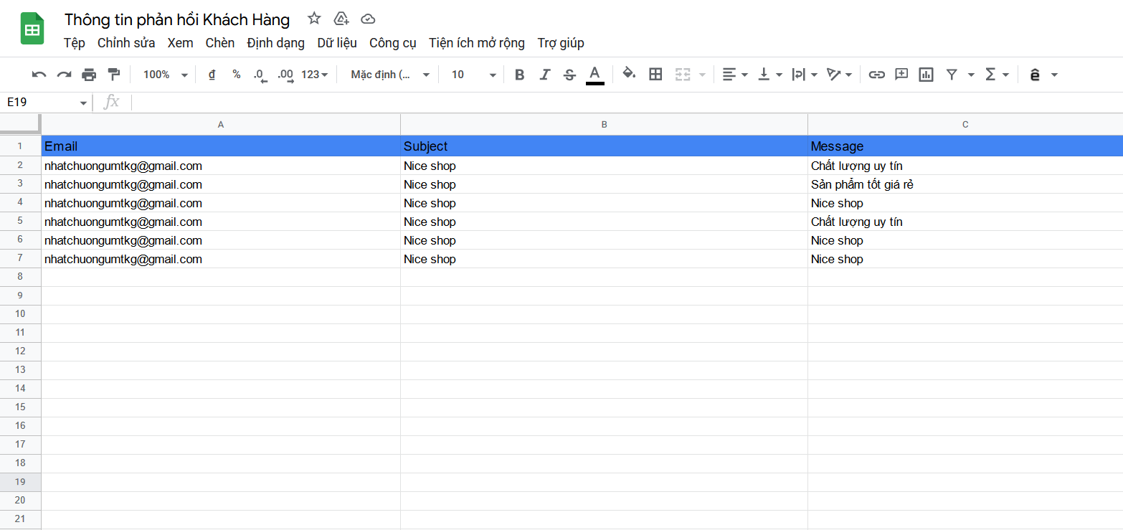
IV. Function
3.5. Check feedback

Slide 37
THANKS!
Any questions?

